Slide 1
Adobe Experience Cloud Customer Support Guide
Information and resources, you need to maximize value of your Adobe solution.

Slide 2
Important information & resources
1
Adobe Experience Core Services
2
Customer Support Services
3
Your Adobe Solutions
4
How to Submit a Support Ticket
5
Engaging with Adobe Support
6
Tools & Resources

Slide 3


Adobe Experience Cloud: An integrated set of solutions to build campaigns, manage your advertising, and gain deep intelligence about your business. Learn more
Adobe Experience Cloud Tutorials
Content & Commerce
Data Insights & Audiences
Adobe Experience manager
Adobe Commerce
Adobe
Analytics
Adobe Customer Journey Analytics
Adobe Real-Time CDP
Adobe Audience manager
Customer Journeys
Marketing Workflow
Adobe Target
Adobe Campaign
Adobe Journey Optimizer
Adobe Marketo Engage
Adobe Workfront

Slide 4


Customer Support Guidelines
The portals and aliases provide access to a wealth of information and support resources. View your open tickets, submit new ones, and contact Customer Support.
What Customer Support Covers
What Customer Support DOES NOT Cover
ü Troubleshooting and resolution assistance for product issues on supported configurations
ü Remote diagnostics
ü Additional Service Enhancements available to customize your support package
ü Product upgrade releases (on premise)
ü Maintenance releases (on premise)
ü Application Integration Issue*
x Architecture reviews
x Custom code review or troubleshooting
x Custom enhancements (submit as idea to the community)
x Knowledge transfer and training services
x Development services
x Implementation
x Third party product or hardware recommendations
x Troubleshooting of non-Adobe products
x Issues from non-supported configurations (Note: Such requests are to be channeled)
x Performance Tuning
x Non-reproducible issues
*Limited to Only Adobe side

Slide 5
Ways to Contact Customer Support
Adobe Customer Support offers support via chat, email, phone, and web. For P1 issues we recommend you contact via phone for immediate assistance.
To enable us to handle your inquiry efficiently, please provide us any and all steps to recreate it on our end; that is, the clearer the details, the better it will be addressed. Upon submitting a ticket, we recommend outlining and/or having ready, depending on the method in which you contact Customer Support, the following applicable information (see page 22 for an example):
The portals and aliases provide access to a wealth of information and support resources. View your open tickets, submit new ones, and contact Customer Support.
ENTERPRISE CLOUD SUPPORT
Support Portal | Phone Support | Adobe Status
Adobe Experience League Support Adobe Experience Manager Support Adobe Campaign Support | Phone number 1 800 497 0335 (U.S. & Canada) Regional phone numbers | Check the Adobe System Status General System Status
*Not all products have a support portal or chat, see each product page for methods to contact support

Slide 6
Who can Contact Customer Support?
Adobe accords highest priority to the security and protection of your data. To ensure that, we encourage you to designate some people from your organization as Named Support Contacts who will have full access to the product, are trained on it and can answer basic questions specific to the implementation.
· Only Named Support Contacts will be authorized to discuss the data and make necessary changes to the account settings.
· People not authorized as Named Support Contact can reach out to Support team, however, will be directed to online help/forums.
Modifying or adding Named Support Contacts
· Only existing Named Support Contacts can get any changes made to the list of existing Named Support Contacts in the same organization.
· Contact Customer Care via phone or email to add/remove users.
ADOBE CUSTOMER SUPPORT – SUPPORTED USERS
 | Online Support | Business Support | Enterprise Support | Elite Support
# Supported Contacts by product | 4 | 6 | 10 | 15

Slide 7
Adobe Customer Support Regional Hours, Language & Phone Options
Adobe’s local business hours align to the customer’s billing region.
Regional Hours of Operations & Language Support
Americas |  | EMEA |  | APAC
U.S | 1 800 497 0335 | Denmark | (+45) 80 20 6017 | Australia | (+61) 1800 358 683
Canada | 1 800 497 0335 | France | (+33) 08 05 540 755 | China mainland | (+86) 108 004 400 548
 |  | Germany | (+49) 0800 752 2581 | Hong Kong SAR of China | (+852) 30 713 107
 |  | Italy | (+39) 800 919 224 | India | (+91) 0008 004 402 107
 |  | Sweden | (+46) 0200 810 330 | Malaysia (toll) | (+60) 1800 220 120
 |  | UK | (+44) 0800 169 0454 | New Zealand (toll) | (+64) 050 861 4264
 |  |  |  | Philippines (toll) | (+63) 1 800 8908 8359
 |  |  |  | Singapore | (+65) 1 800 818 5220
 |  |  |  | South Korea | (+82) 080 517 0880
 |  |  |  | Taiwan region | (+886) 0 800 066 6381
Americas | Europe, Middle East & Africa
6 am to 5:30 pm | 9 am to 5 pm
Asia Pacific | Japan*
9 am to 5 pm | 9 am to 5:30 pm
Exceptions:
*Language support is available only in English and Japanese.
Adobe Commerce excludes Japanese language support.
(Japan) P2, P3, P4 cases are limited to business hours only.
Marketo Engage Phone Support
Americas | Europe, Middle East, & Africa | APAC | Japan
Toll Free: +1 877 270 6586 | UK: 0800 151 3030 EU: +353 1 242 3030 | AUS: +61 2 8031 8188 | +81 3 6478 6080
If your locale is not represented with a specific customer care telephone number, please use +1 800 497 0335. Please note that this is a number in the USA, so call charges may apply in your market.

Slide 8
Adobe Customer Support Priority Definitions
We base the response times and actions on an assessment of the impact reported by your business. The more serious the business impact, the higher the assigned priority. The following guidelines will assist you in determining the appropriate priority level.
Service Level Targets: Initial Response & Priority Definitions
Priority | Definitions | Online Support | Business Support | Enterprise Support | Elite Support
PRIORITY 1 | Customer’s production business functions are down or have significant data loss or service degradation and immediate attention is required to restore functionality and usability. | 24x7 / 1 hour | 24x7 / 1 hour | 24x7 / 30 minutes | 24x7 / 15 minutes
PRIORITY 2 | Customer’s business functions have major service degradation or potential data loss, or a major feature is impacted. | Business hours / 4 hours | Business hours / 2 hours | 24x5 / 1 hour | 24x5 / 30 minutes
PRIORITY 3 | Customer’s business functions has minor to no service degradation but there exists a solution/workaround allowing business functions to continue normally. | Business hours / 6 hours | Business hours / 4 hours | Business hours / 2 hours | 24x5 / 1 hour
PRIORITY 4 | General question regarding current product functionality or an enhancement request. | Business days / 3 days | Business day / 1 day | Business day / 1 day | Business day / 1 day

Slide 9



Adobe Analytics: Industry-leading solution for collecting, organizing, analyzing, and reporting on everything your customers do.
Insights Into Results
New Algorithmic Attribution Model
Customer Journey Analytics
Business users and senior decision-makers can now access insights easily and quickly on their mobile devices and get instant answers to interactive queries.
Users can now evaluate their marketing investments more precisely across paid, earned, and owned media.
Empower business intelligence and data science teams to stitch and analyze cross-channel data with a powerful analytics toolkit.
Implementation Guide
Analytics Community
Learn & Support
Analytics Exchange
Analytics Documentation

Slide 10



Adobe Audience Manager: Data management platform that helps you build unique audience profiles so you can identify your most valuable segments and use them across any digital channel.
Understand Your Audiences
Create New Segments
Advertise Effectively
Get a complete view of your audience by combining all of your data sources in one place.
Continually discover and organize new, valuable segments for smarter targeting and personalization.
Make your ad campaigns more productive by targeting specific segments on any platform.
Implementation Guide
Audience Manager Documentation
Learn & Support
Audience Manager Exchange
Audience Manager Community

Slide 11



Adobe Target: makes it easy to identify your best content through tests that are easy to execute. So, you can deliver the right experience to the right customer.
Take omnichannel personalization
to the masses
Stop guessing with A/B and multivariate testing
Improve every experience with AI-powered automation & scale
The best experiences are consistently personal. Use our unified, progressive profile to give the best experience through every channel.
Running isolated tests in silos just doesn’t cut it. Easily test everything through every channel every time.
Test and personalize to every visitor, applying artificial intelligence with a single click.
Implementation Guide
Target Community
Learn & Support
Target Exchange
Target Documentation

Slide 12





Adobe Experience Manager: powerful platform to manage and deliver connected digital experiences across the customer journey from online to physical interactions.
Content Management System
Digital Asset Management
Digital Enrollment and Forms
AEM Cloud Service
Digital Signage
Create and manage your digital experience across all channels with automated tools that make scaling effortless.
Spend more time on experiences and less time searching for and adapting content.
End-to-end solution that connects your forms and communications processes.
The first cloud-native enterprise-grade content management system featuring optimal performance, with great SLAs and security.
Easily connect online and in-store experiences with interactive signage that’s responsive to customer data and on-side triggers.
Experience Manager Community
Learn & Support
Core Components
Ask the Expert Sessions
Experience Manager Security Updates
Implementation Guide AEM Sites
Implementation Guide Experience Manager Assets
Implementation Guide Experience Manager Forms
Experience Manager as a Cloud Service Overview
Experience Manager Documentation
Experience Manager as Cloud Service User & Implementation Guides

Slide 13



Adobe Campaign: Cross-channel campaign management tool that helps you improve and personalize campaigns across all of your media.
Simplify Campaign Management
Be More Engaging
Automate
Manage your data and monitor the performance of your campaigns from one place.
Use personalized, contextual, and real-time messages to deliver a compelling customer experience.
Use marketing automation to increase your campaign productivity and reduce your time to market.
Implementation Guide Campaign Classic
Campaign Community Classic
Learn & Support Campaign Classic
Implementation Guide Campaign Standard
Campaign Community Standard
Learn & Support Campaign Standard
Campaign Exchange

Slide 14

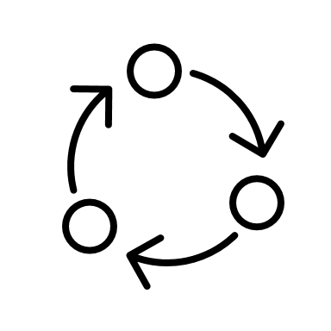

Adobe Experience Platform: Platform enables organizations to centralize and standardize customer data and content from any system and apply data science and machine learning to dramatically improve the design and delivery of rich, personalized customer experiences.
Customer Journey Analytics
Journey Orchestration
Real-time CDP
Adobe’s next-generation solution for cross-channel analytics, based on Adobe Experience Platform
As a business user, learn how to combine event, orchestration, and action activities to build a journey
Achieve a single view of your customer by combining data from across the enterprise
Implementation Guide
Experience Platform Community
Learn & Support
Experience Platform Exchange
Experience Platform Documentation
Create Support Case

Slide 15

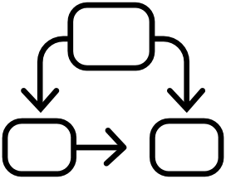

Adobe Primetime: Multiscreen TV platform that helps broadcasters, cable networks and service providers create and monetize engaging and personalized TV and film experiences.
Deliver TV Everywhere
Create Flexible Workflows
Offer Insights and Results
Give viewers the TV and film content they want anywhere, across 3.4 billion devices.
Add modular capabilities to your existing broadcast and distribution workflows, including VOD, live and linear TV.
Insights from Adobe Marketing Cloud integrations allow media sellers to optimize campaign and ad delivery in real time.
Primetime Documentation
Learn & Support

Slide 16


Adobe Marketo Engage: Keep customers engaged every step of the way by radically transforming the customer experience management with Marketo Engage.
Grow Customer Relationships
Scale up Your Marketing
Master Account-Based Marketing
Retain & grow customers through data-driven engagement. Improve customer experience. Enablement better onboarding and long-term customer success.
Increase scale and efficiency like a pro. Tap into technology to grow reach, quality and ROI.
Acquire, retain, and grow your high-value accounts. Quickly build target account lists. Measure & optimize ABM holistically. Get a seamless cross-channel experience.
Marketo Community
Support Portal
Marketo Documentation
Knowledgebase
Marketo Exchange

Slide 17


Adobe Commerce: End-to-end commerce that grows with you — any size, any place.
Single Platform for all your needs
Intelligence from industry-leading AI
Extensible to incorporate technology
Whether you’re a B2B ready to go direct to consumer (D2C) or a B2C, Adobe Commerce lets you manage multiple sales channels and brands and expand into new countries, simply, from one platform.
Intelligent commerce, powered by Adobe Sensei AI, provides actionable data analysis and automates back-end workflows
Adobe Commerce is completely scalable and extensible, with a modular core and headless capabilities that allow you to quickly incorporate new technologies
Implementation Guide
Commerce Community
Knowledgebase
Commerce Exchange
Commerce Documentation
Create Support Case

Slide 18

Adobe Workfront: Connect, collaborate, and execute on complex workflows—from anywhere.
Adobe Workfront in Action
Workfront Features
Enterprise Management
Plan, prioritize, and iterate your work.
Connect, collaborate, and finish work faster.
Streamline and optimize processes. Measure and report on progress.
Keep work aligned with strategy.
With Workfront, enterprise work management can help your company, departments plan, predict, collaborate, evolve, and deliver their best work.
Workfront provides marketing and creative teams that use Adobe products with an enterprise platform for modern work management increasing overall productivity across the business.
Implementation Guide
Workfront Community
Getting Started
Workfront Exchange
Workfront Documentation
Workfront Support Portal

Slide 19



Adobe Ad Cloud: helps you forecast the best mix of search, display and dynamic ads based on your budget. It also automates the execution of your media plan.
See the Big Picture
Act with Confidence
Maximize Your Budget
Get a complete view of your campaign performance across search, display and social to better understand how customers interact with your brand.
The accuracy reporting feature helps you know when and where to invest your online advertising budget.
Get more return from your advertising budget, knowing it’s being spent in the most strategic and efficient way.
Advertising Cloud Exchange
Advertising Cloud Community
Learn & Support

Slide 20
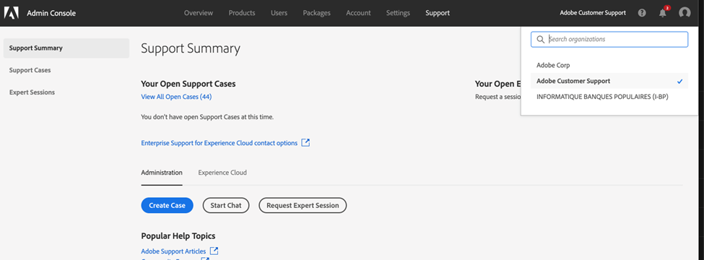
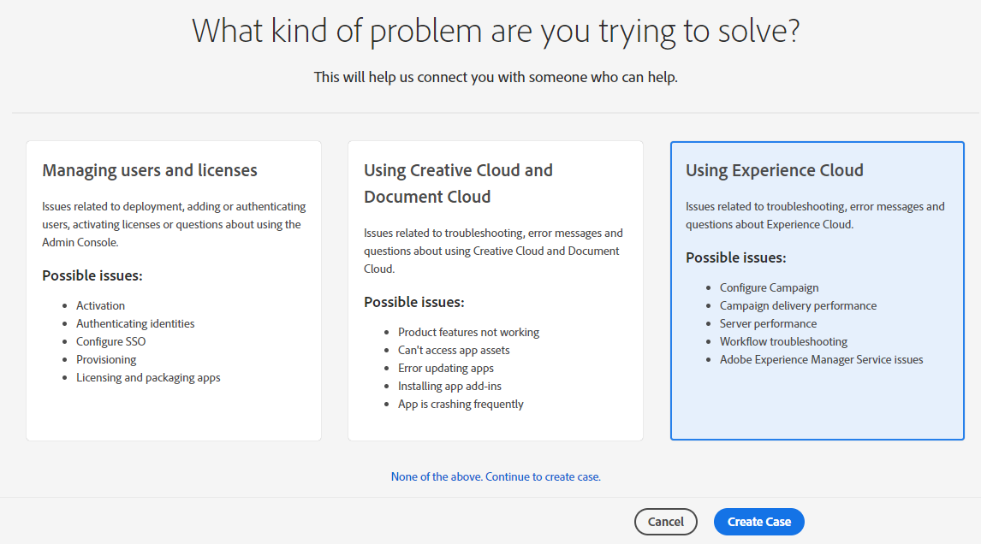
Create a Support Case | Adobe Experience Manager, Adobe Experience Platform & Adobe Campaign
Follow the below steps to create a support case in the Admin Console for the following solutions:
Adobe Experience Manager
Adobe Experience Platform
Adobe Campaign
ACTION | Login to the Admin Console, navigate to Support > Support Summary Click Create Case Select the category your issue falls into: Managing Users & Licenses Using Creative Cloud & Document Cloud Using Experience Cloud Click Create Case
A video walkthrough of how to raise and manage a support case in Admin Console can be found here
In the form that appears, specify the name of the product you need assistance with. To see a list of options, type the first few letters of the product name.

Slide 21
Case Description | Adobe Experience Manager, Adobe Experience Platform & Adobe Campaign
When the case form appears, complete the details about the issue using the below information as guide:
Category | Description
Specify a product | Specify the name of the product in the given field. To see a list of options, type the first few letters of the product name. This option is not available if you create a case for managing users and licenses.
Select the priority of the issue | Depending on how the issue impacts your operations, classify it as follows: P4 (Minor): Select this option if the issue does not cause any significant interruptions to normal operations. This option can include issues related to APIs and integration, installation and configuration inquiries, enhancement requests, or documentation questions. P3 (Important): If the issue interrupts normal operations, select this option. For example, malfunctioning or incorrect behavior of the software. P2 (Urgent): Choose this option when there are serious interruptions to your business' normal operations. For example, if the issue negatively impacts an enterprise-wide installation, urgent deadlines, or causes financial risk to business.
Quantify the impact of the issue | Based on the scale at which the issue affects your organization, select one from the following options: Small: One or two users impacted Medium: A specific group of users impacted Large: Most users impacted
Category | Description
Summarize the issue | Provide a descriptive summary of your issue. Mention what the specific problem is and what you are seeing. Examples of descriptive summaries: Error "Could not process incoming SAML response" with Federated ID "Account not recognized" in the support panel Error 400 or other error when attempting to validate a domain claim Users, groups, or identity panel is blank Change Domain Claim from Enterprise ID to Federated (or conversely) Receiving the error "An invitation with this code was not found"
Describe the nature of the issue | State your queries or describe your issue in detail, including the workflow that caused the issue and steps to reproduce. Include details about when it first happened.
Attach screenshots or files | You can attach relevant files under 20MB to the case. For example, a screenshot of the error. Executable and DLL files are not supported.
Note: For P1 (Critical) support issues, please call Adobe Customer Support. Phone numbers are listed here.

Slide 22
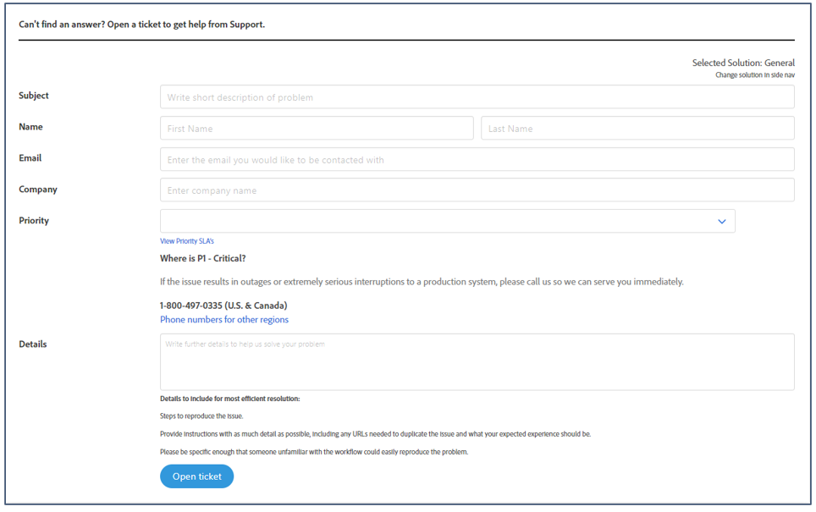
Create a Support Case | Adobe Analytics, Adobe Audience Manager, Adobe Target
Follow the below steps to create a support case in Experience League Portal for the following solutions:
Adobe Analytics
Adobe Audience Manager
Adobe Target
Adobe Social
ACTION | Navigate to Experience League Submission Ticket Site Select from the left tab which solution you need help for: Complete the form with the following information/details Subject of your inquiry or issue Your First and Last Name Your email address Your company name Enter Priority P1 require a phone call P2 urgent P3 important P4 minor (just need to know) Provide details of the inquiry or issue
Email confirmation should come if your email is registered as a supported user (system generated) and once a ticket is assigned to a Service Desk engineer, they will email you back.

Slide 23
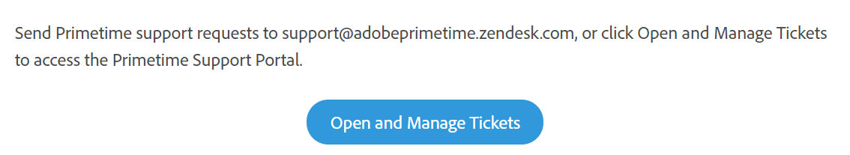
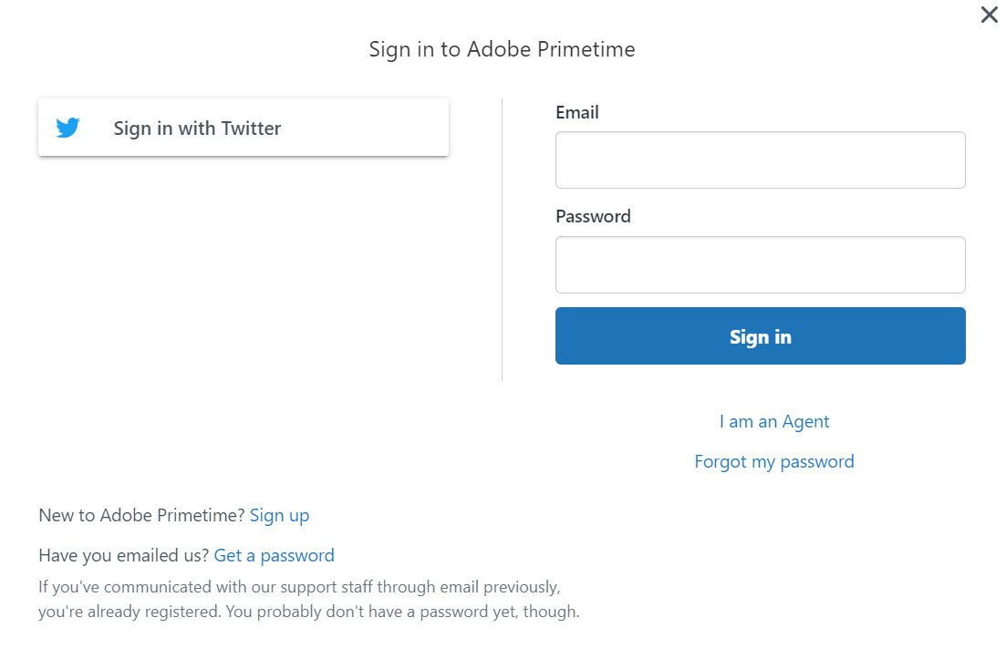
Create a Support Case | Adobe Primetime
Follow the below steps to create a support case in Experience League Portal for the following solutions:
Adobe Primetime
ACTION | Navigate to Experience League Submission Ticket Site Select from the left tab which solution you need help for: Complete the form with the following information/details Summary Steps to reproduce the issue Recent environment changes Screenshots Error messages Log files
Direct access to Adobe Primetime & direct access to Adobe Commerce Support Portal

Slide 24
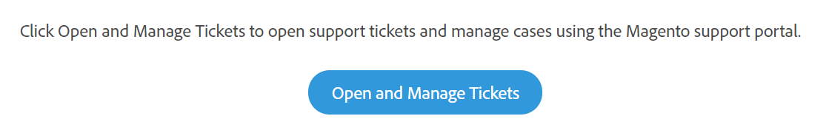
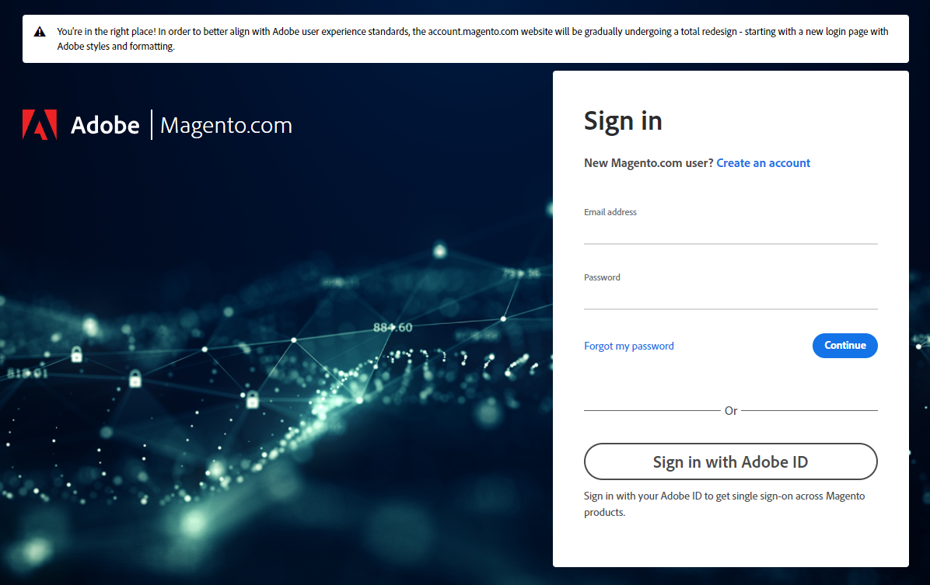
Create a Support Case | Adobe Commerce
Follow the below steps to create a support case in Experience League Portal for the following solutions:
Adobe Commerce
ACTION | Navigate to Experience League Submission Ticket Site or navigate directly to https://support.magento.com & log In Select from the left tab which solution you need help for: Complete the form with the following information/details Project URL Environment Live or not live Steps to reproduce the issue Recent environment changes Screenshots Error messages Log files
Direct access to Adobe Commerce Support Portal

Slide 25
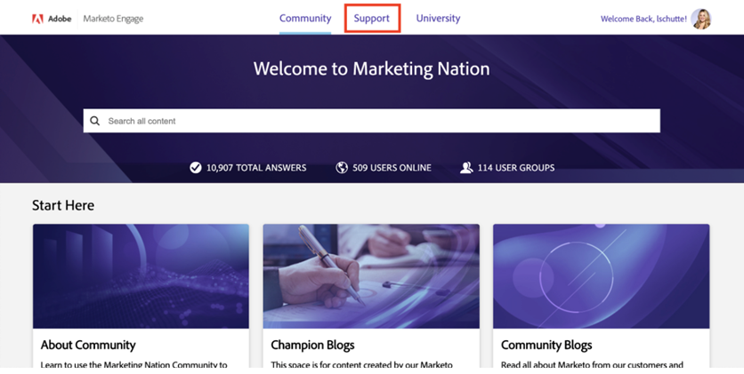
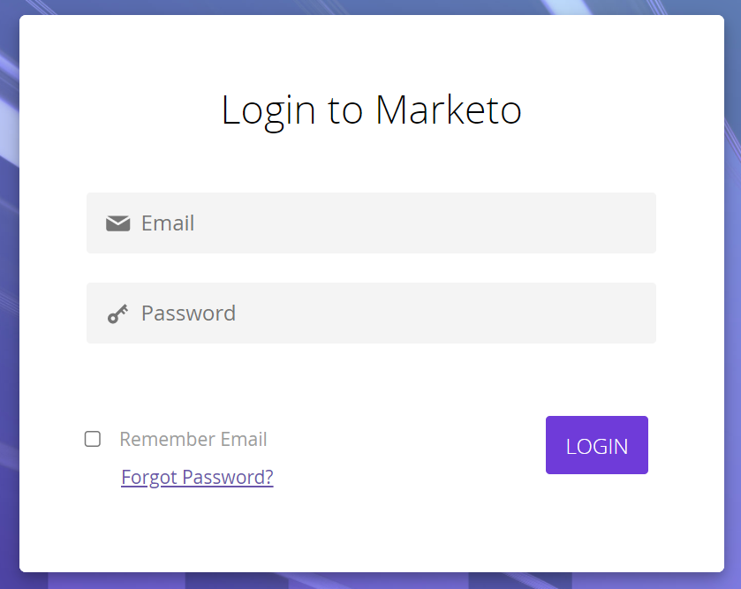
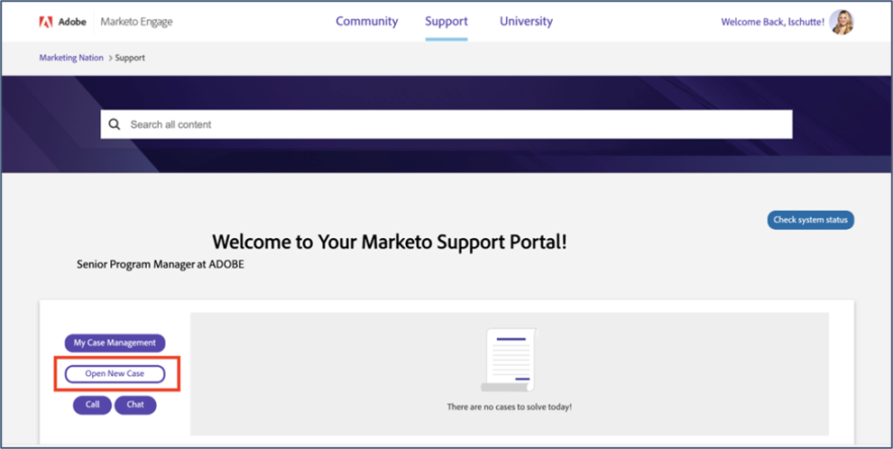
Create a Support Case | Adobe Marketo Engage
Follow the below steps to create a support case in Marketo Nation for the following solutions:
Marketo Engage
ACTION | Navigate to Experience League Submission Ticket Site or navigate directly to Marketing Nation & log in Click the Support option Click Open New Case button Complete the form with the following information/details Subject Description Priority Case Type Case Issue Case Sub Issue Instance (if applicable) Email cc list Remote access permission Screenshots A video walkthrough of how to use the Support Portal can be found here
Direct access to Adobe Marketo Engage Support Portal

Slide 26



Engaging With Adobe Customer Support
Adobe Customer Support specialists are extensively trained in all Adobe Experience Cloud solutions. They are qualified to
help you with questions relating to solution capabilities, configurations, issues and general ‘how tos’.
Who can contact Adobe
Support?
Modifying or adding Named
Support Contacts
How to contact Adobe
Support?
Adobe accords highest priority to the security and protection of your data. To ensure that, we encourage you to designate some people from your organization as Named Support Contacts who will have full access to the product, are trained on it and can answer basic questions specific to the implementation.
Only Named Support Contacts will be authorized to discuss the data and make necessary changes to the account settings.
People not authorized as Named Support Contact can reach out to Support team, however, will be directed to online help/forums.
Only existing Named Support Contacts can get any changes made to the list of existing Named Support Contacts in the same organization. Contact Customer Support via phone or email to add/remove users.
Experience League Support: https://experienceleague.adobe.com/?support-solution=General#support
Phone Numbers: https://helpx.adobe.com/contact/dma external/DMACustomeCareRegionalPhoneNumbers.html

Slide 27




Tools & Resources
Adobe offers you a wealth of information and resources. To get started, we recommend you explore the following:
Experience Cloud Release Notes – Early Access
Security Notification
Service
Priority Product Update Service
Experience League
Subscribe to keep yourself updated about new features and fixes in the Adobe Experience Cloud
Learn more>
Timely and accurate information that can help protect you against malicious hacking
Learn more>
Stay on top of the latest Adobe Experience Cloud product updates and maintenance releases
Learn more>
Expertly curated learning courses, tutorials and documentation, communities, and support resources
Learn more>

Slide 28


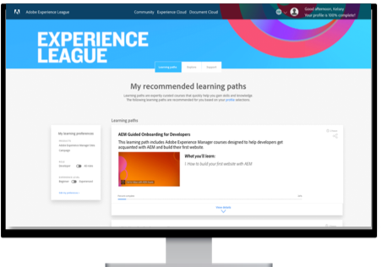
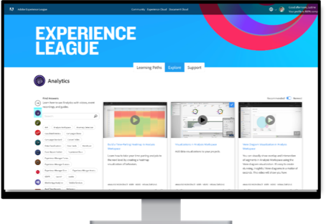
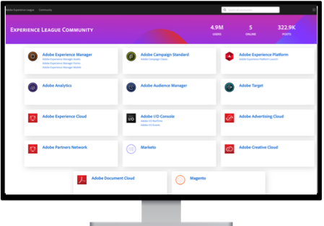
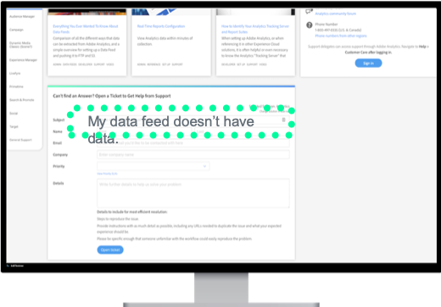
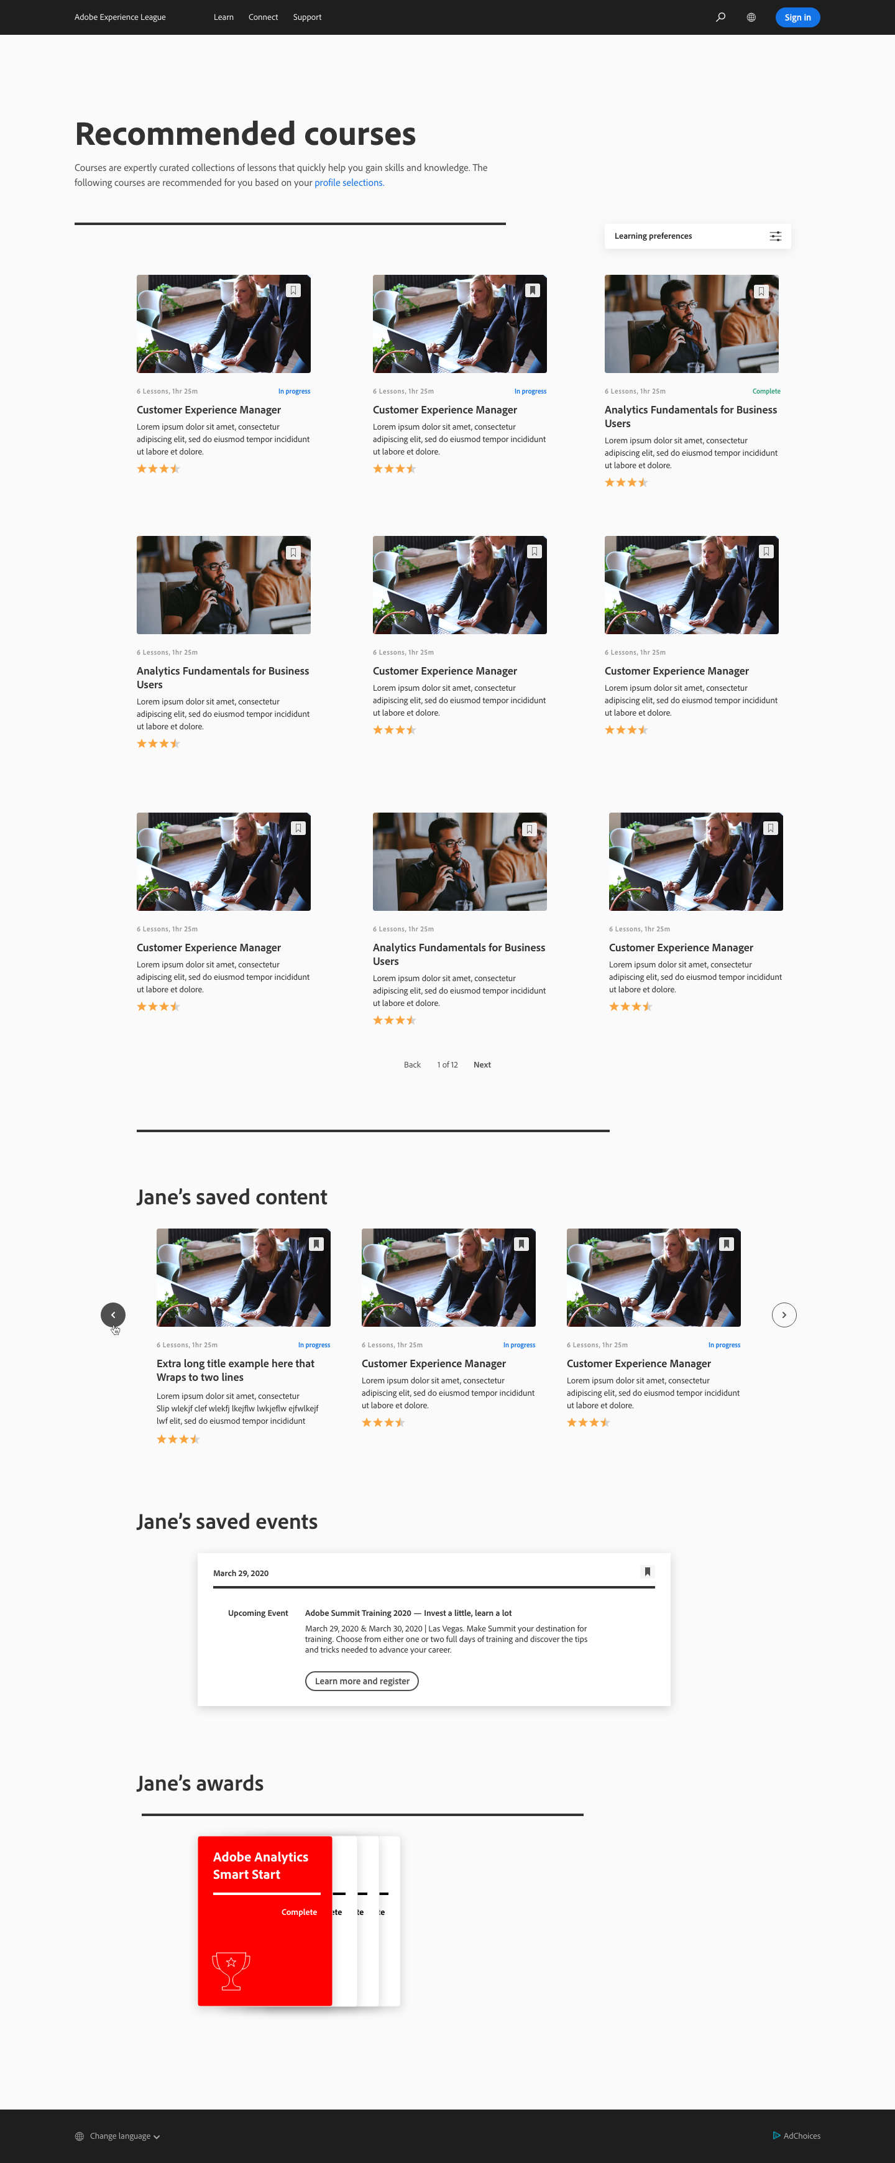
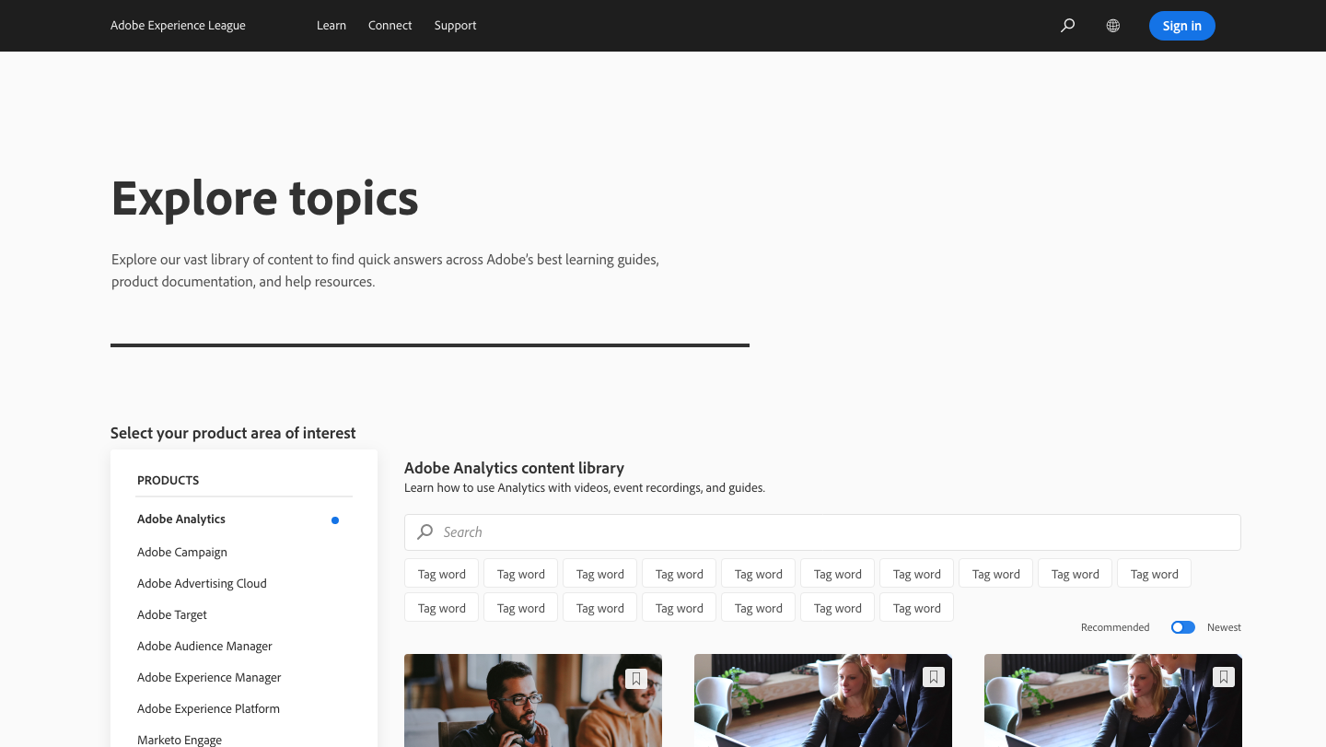
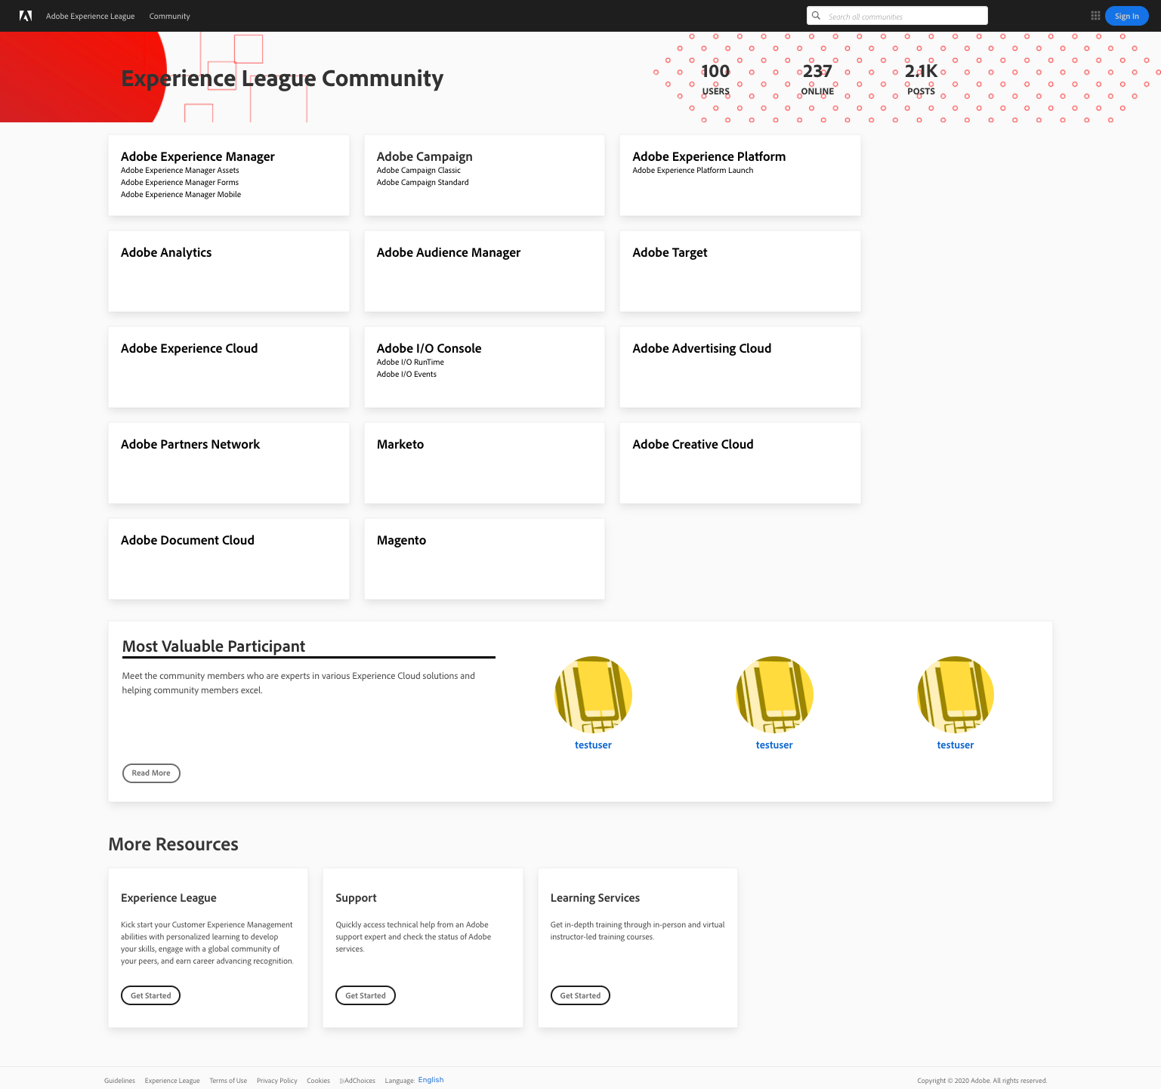
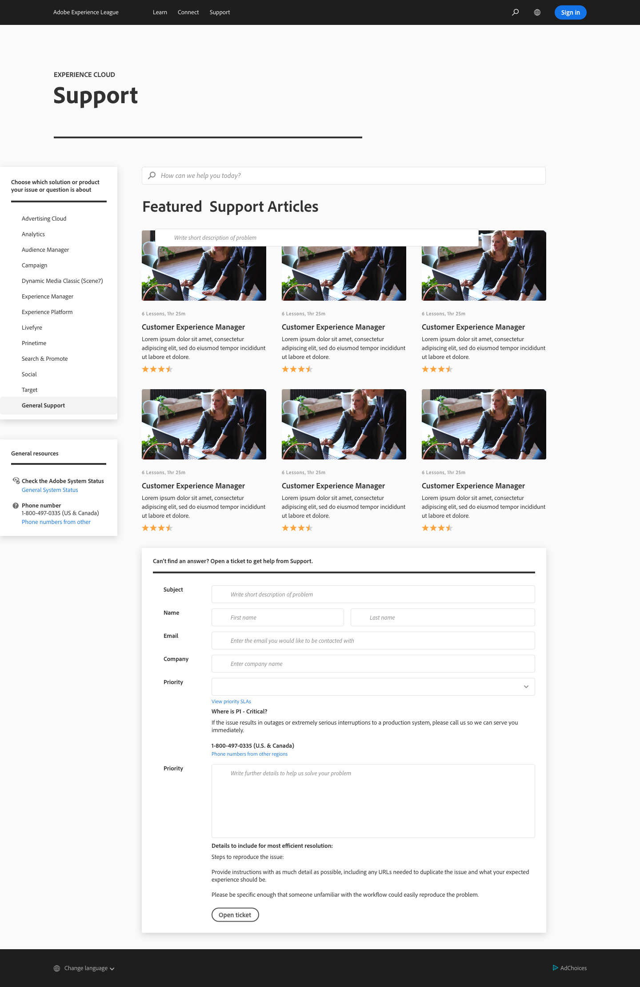


Experience League is a unified place where our customers can Learn, Connect, and Grow along a personalized path to success that includes self-help and instructor-led training, community and other support options.
Learn. Connect. Grow.
experienceleague.adobe.com
Guided learning designed
by Adobe experts
Quick answers from product guides and support articles
Communities of experts and fellow learners
Online support
Experience League is GLOBAL!
(12 languages)
Experience League is MOBILE!

Slide 30
Premier Support
Offerings: Business Support | Enterprise Support | Elite Support

Slide 31




Business Support
Delivery Team & Features
Assigned Expert | Account Support Lead | ✓
Support Services | Online Support | Business Hours
 | 24x7 P1 Issue Support | ✓
 | Named Support Contacts | 6
 | Live Telephone Support | ✓
 | Escalation Management | ✓
Levels & Features
Online Support
Access to online resources for documentation, engagement with other experts and customers for best practices, and webinar series (Office Hours). For troubleshooting tips and tricks, several channels are also available for questions and case submissions.
24x7 access to Communities
Engagement with other customers
Web case submission
Online Forums
https://experienceleaguecommunities.adobe.com/
Live Chat Support*
Start a chat session to get answers and help with case submission
* Not all products have live chat support.
Enablement
Self Guided journeys
Monthly Office Hours
Product & Release Documentation
https://experienceleague.adobe.com/
24x7 P1 phone support
Talk to an Adobe expert or your Named Support Engineer
Named Support Contacts – List of 6 Users authorized to interact with Customer Support
https://adobe.ly/businesssupport

Slide 32
Enterprise Support
Delivery Team & Features
Assigned Expert | Named Support Engineer | ✓
Support Services | Online Support | 24x5
 | 24x7 P1 Issue Support | ✓
 | Named Support Contacts | 10
 | Live Telephone Support | ✓
 | Escalation Management | ✓
 | Support Reviews per Year | 2
 | Expert Sessions per Year | 2
 | Cloud Support Activities – Experience Manager as Cloud | ✓
Field Services | Launch Advisory Services – First Year of new solution | ✓
 | Field Services Activities | 2
Levels & Features
Online Support
Access to online resources for documentation, engagement with other experts and customers for best practices, and webinar series (Office Hours). For troubleshooting tips and tricks, several channels are also available for questions and case submissions.
24x7 access to Communities
Engagement with other customers
Web case submission
Online Forums
https://experienceleaguecommunities.adobe.com/
Live Chat Support*
Start a chat session to get answers and help with case submission
* Not all products have live chat support.
Enablement
Self Guided journeys
Monthly Office Hours
Product & Release Documentation
https://experienceleague.adobe.com/
24x7 P1 phone support
Talk to an Adobe expert or your Named Support Engineer
Named Support Contacts – List of 10 Users authorized to interact with Customer Support
https://adobe.ly/enterprisesupport

Slide 33
Elite Support
Delivery Team & Features
Assigned Expert | Named Support Engineer | ✓
 | Technical Account Manager | ✓
Support Services | Online Support | 24x5
 | 24x7 P1 Issue Support | ✓
 | Named Support Contacts | 15
 | Live Telephone Support | ✓
 | Escalation Management | ✓
 | Service Reviews per Year | 4
 | Expert Sessions per Year | 4
 | Event Management | ✓
 | Environment Review, Maintenance & Monitoring​ | ✓
 | Release, Migration, Upgrade & Product Roadmap Review | ✓
 | Cloud Support Activities – Experience Manager as Cloud | ✓
Field Services | Launch Advisory Services – First Year of new solution | ✓
 | Field Services Activities | 4
Levels & Features
Online Support
Access to online resources for documentation, engagement with other experts and customers for best practices, and webinar series (Office Hours). For troubleshooting tips and tricks, several channels are also available for questions and case submissions.
24x7 access to Communities
Engagement with other customers
Web case submission
Online Forums
https://experienceleaguecommunities.adobe.com/
Live Chat Support*
Start a chat session to get answers and help with case submission
* Not all products have live chat support.
Enablement
Self Guided journeys
Monthly Office Hours
Product & Release Documentation
https://experienceleague.adobe.com/
24x7 P1 phone support
Talk to an Adobe expert or your Named Support Engineer
Named Support Contacts – List of 15 Users authorized to interact with Customer Support
https://adobe.ly/elitesupport

